Slide 1

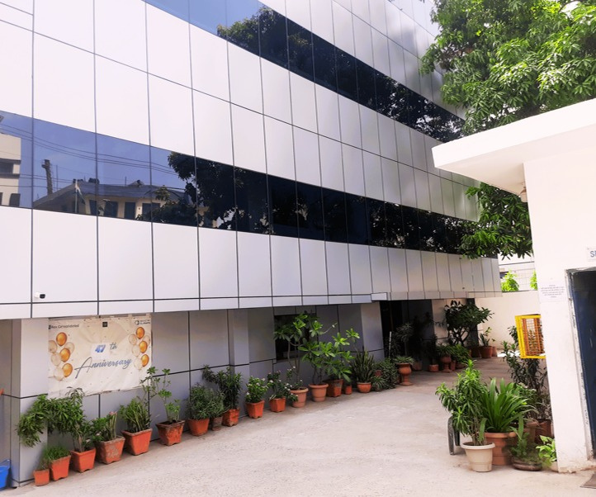



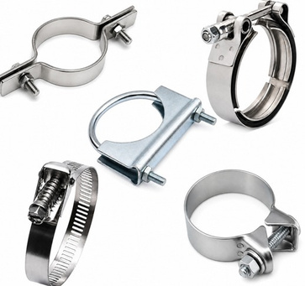
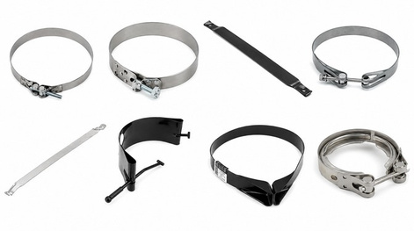
Welcome to Invicta Clamps
'Since1978' and'OEM•Aftermarket•GlobalExport'
45+ Years Of ManufacturingExcellence
OEM
AFTERMARKET

Slide 2
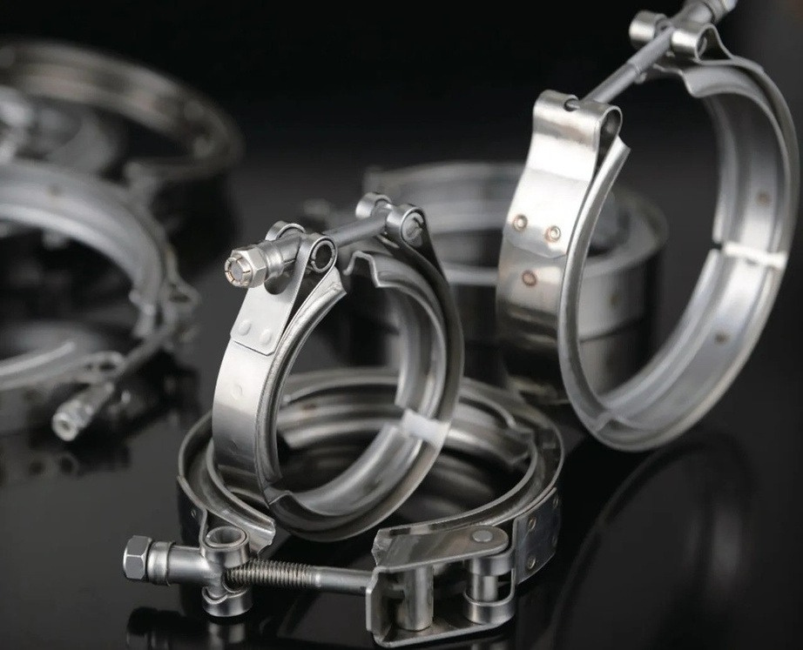
ABOUT US
Engineering High-Performance Clamping Solutions Since 1978
Founded in 1978, Invicta Clamps is one of India's leading manufacturers of exhaust clamps, air tank clamps, V-band clamps, and custom clamping solutions. We design and manufacture precision-engineered products that meet the demanding requirements of the automotive, commercial vehicle, industrial, agricultural, marine, and heavy equipment sectors.
From our integrated manufacturing facilities in India, we supply
OEMs,
aftermarket customers across more than 40 countries, delivering consistent quality, competitive pricing, and dependable global supply.
Tier-1
suppliers,
distributors,
and

Slide 3

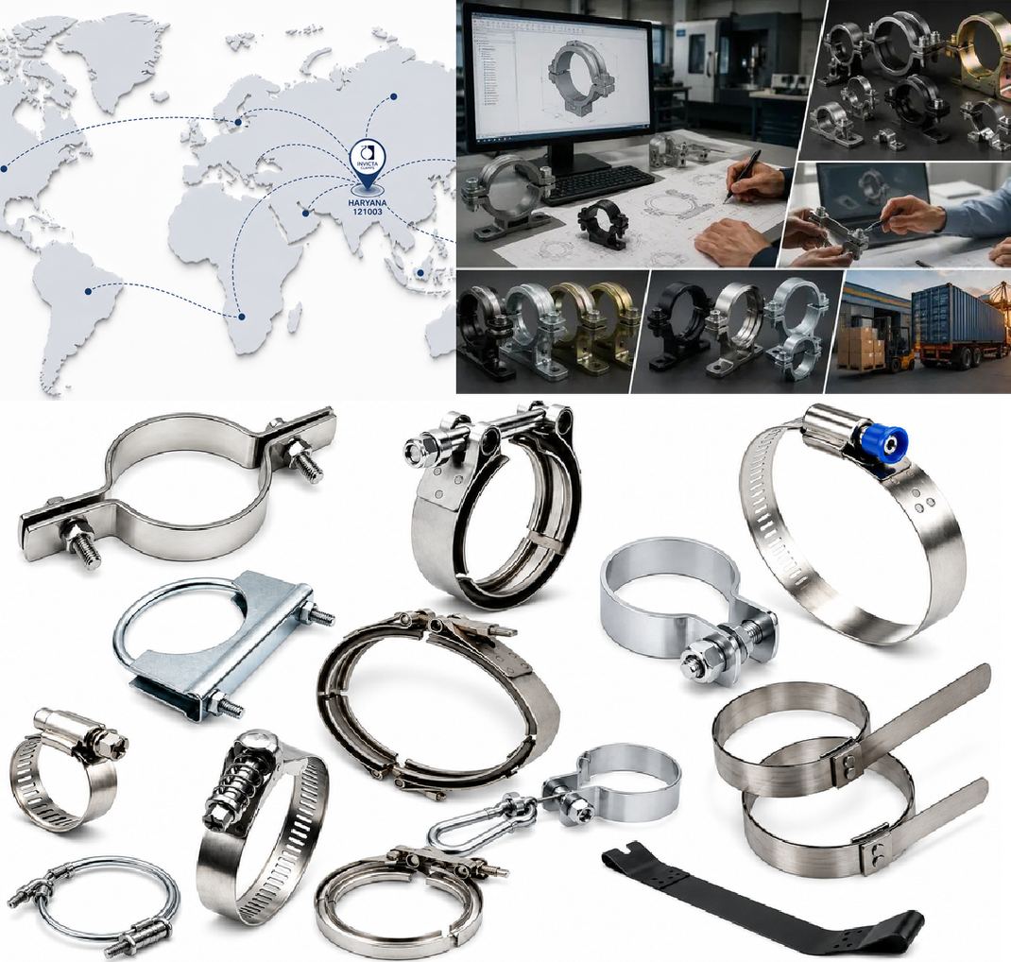
Why Choose Invicta

Slide 4
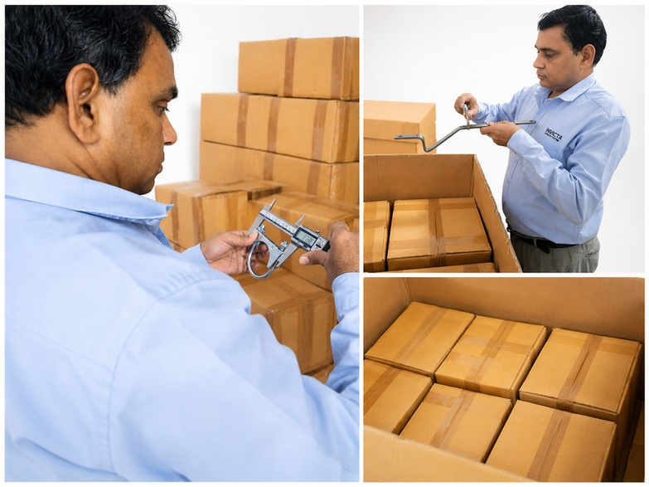
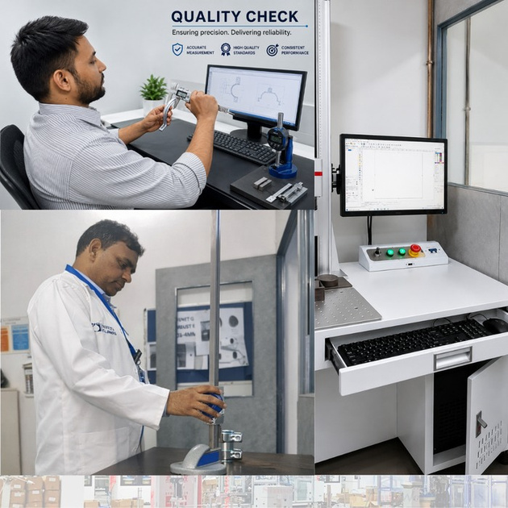
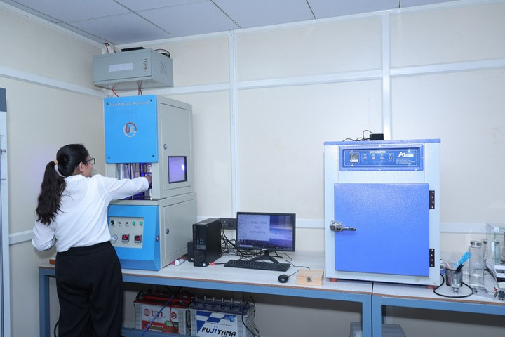
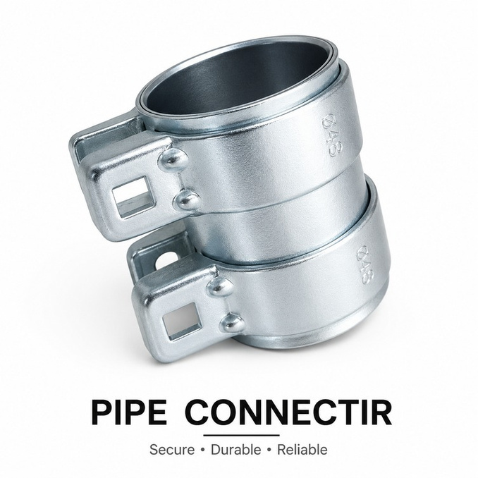
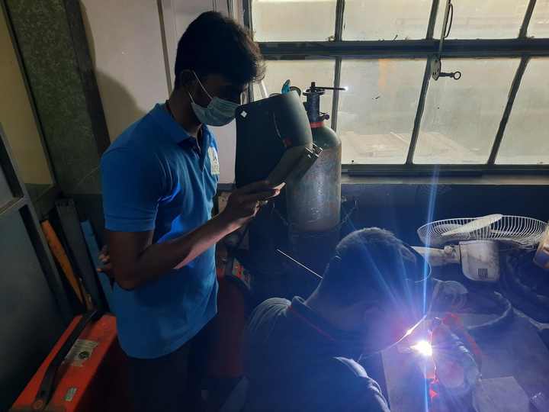

Testing and QualityInspection
Material Testing Final Inspection CMM Inspection
Traceability
Salt Spray Testing
Welding Inspection

Slide 5
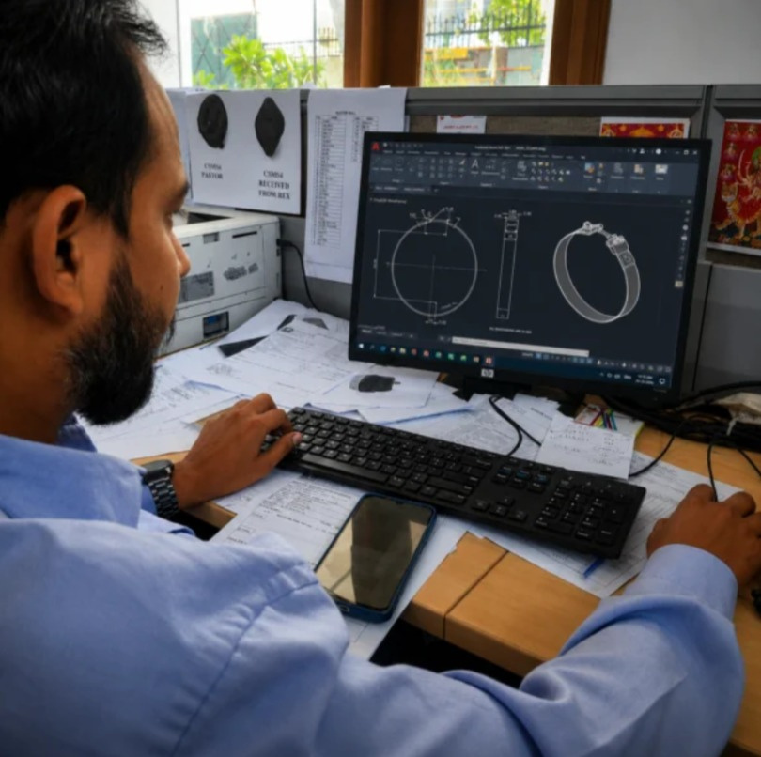
SOFTWARE CAPABILITIES
SolidWorks AutoCAD
CATIA
ANSYS
Creo

Slide 6
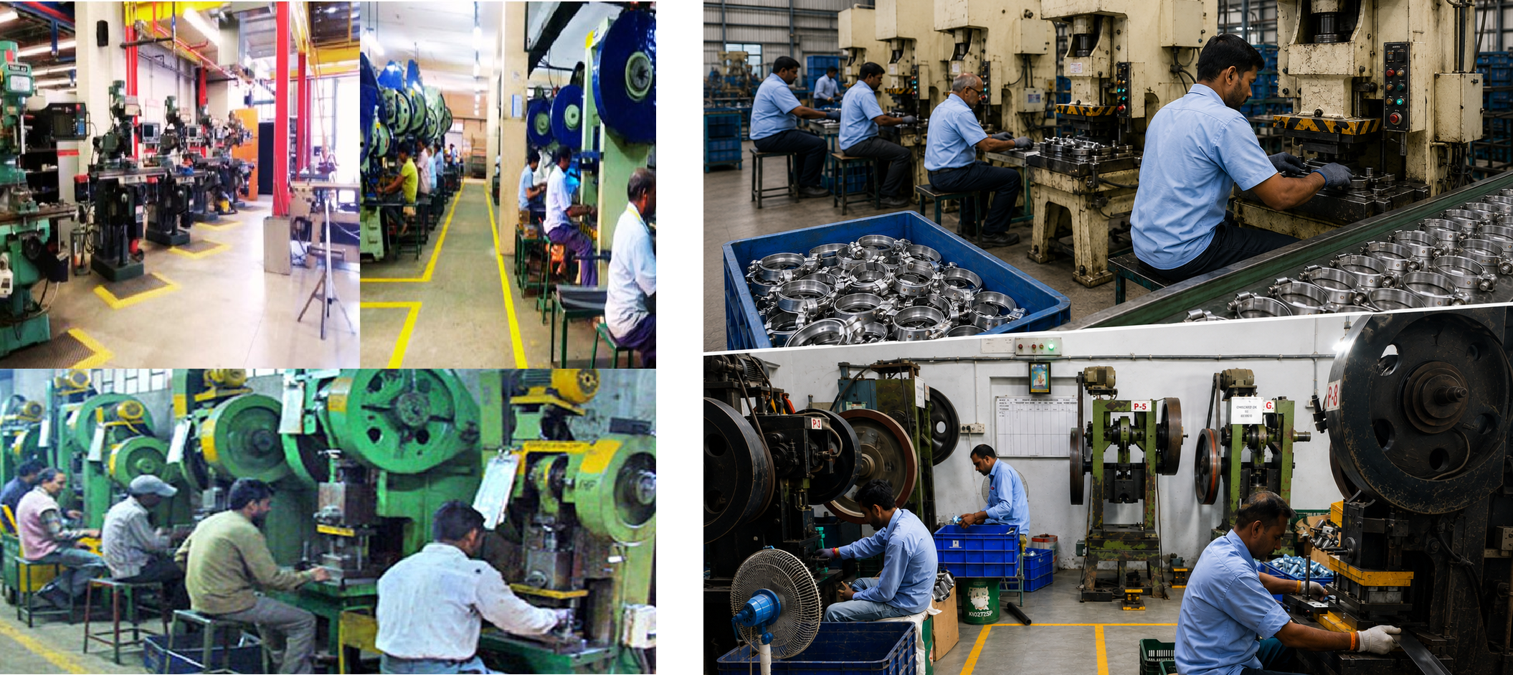
MANUFACTURING FACILITIES & PLANT OVERVIEW

Slide 7
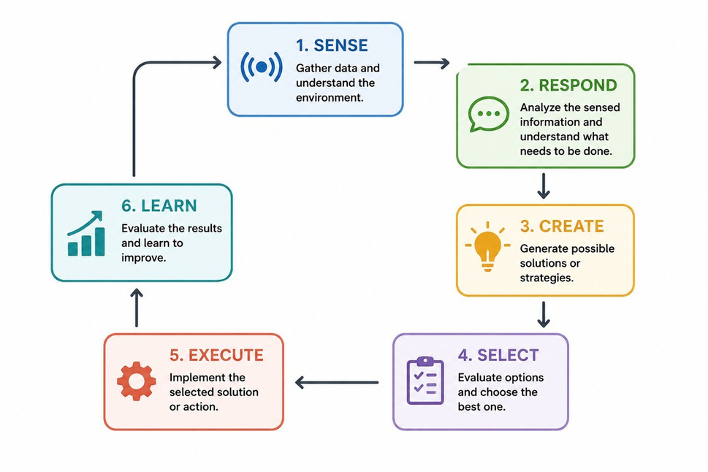
Research &Development
CAD Design
Reverse Engineering
FEA
Prototype Development Custom Tooling.

Slide 8
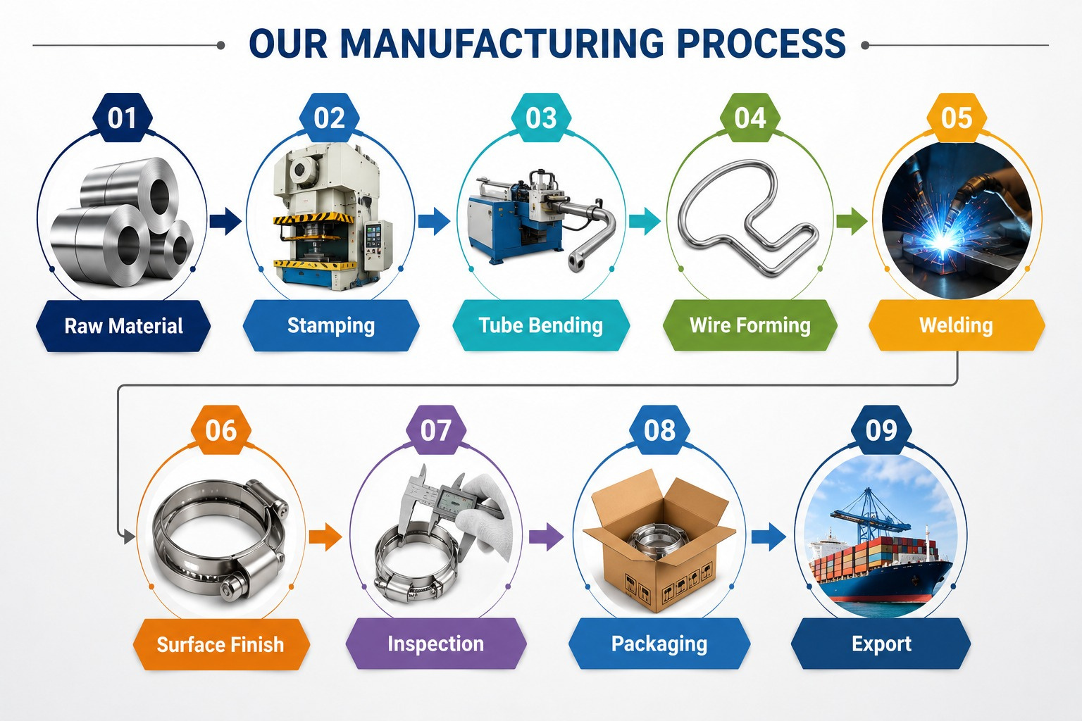
Our Manufacturing Process

Slide 9
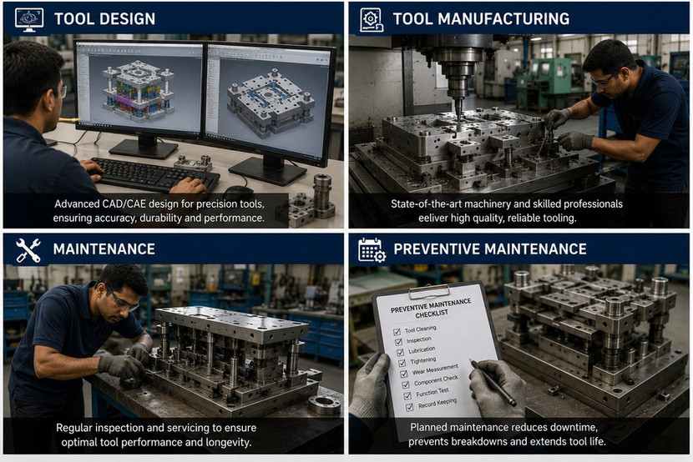
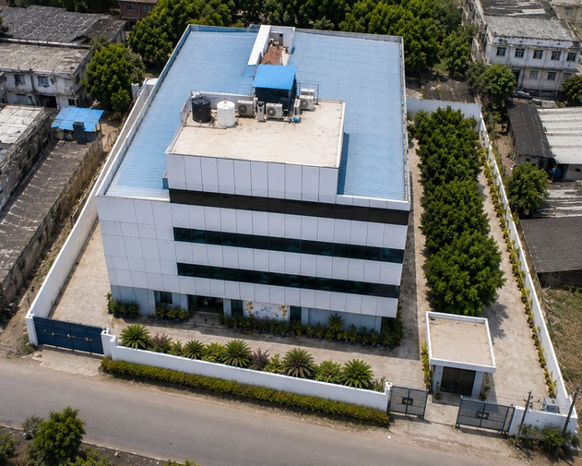
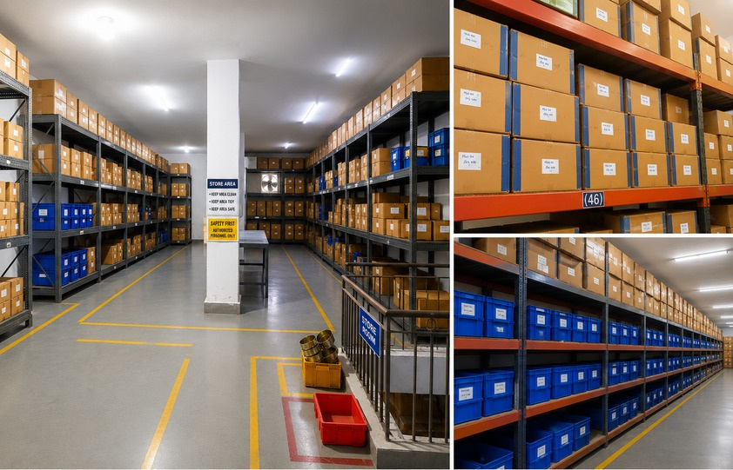
Units
Units-1
Units-2
Units-3
Units-4
Units-5
Units-6
Units-7

Slide 10
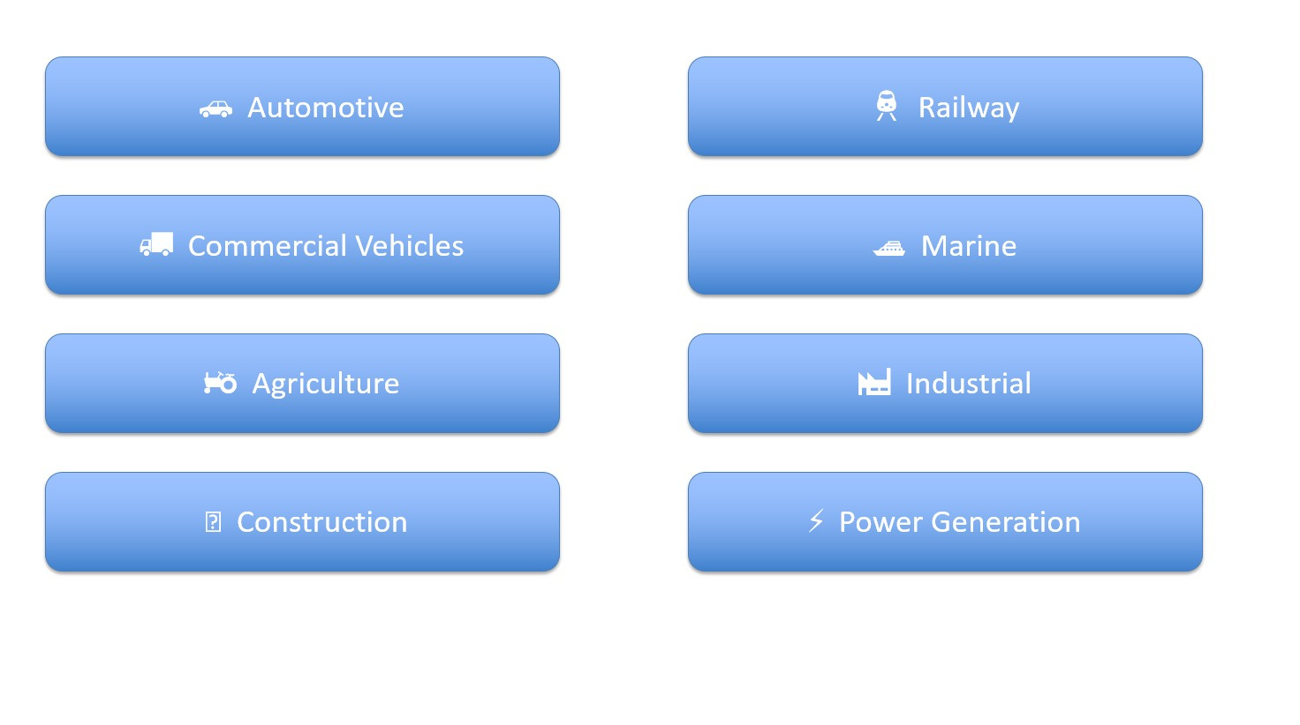
Industries Served

Slide 11
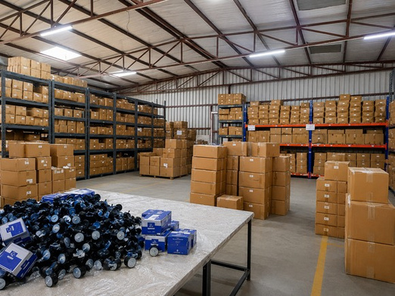
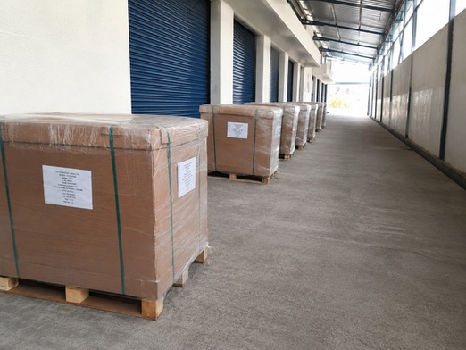
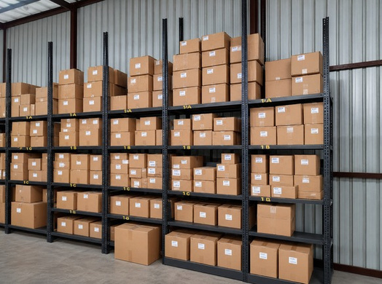
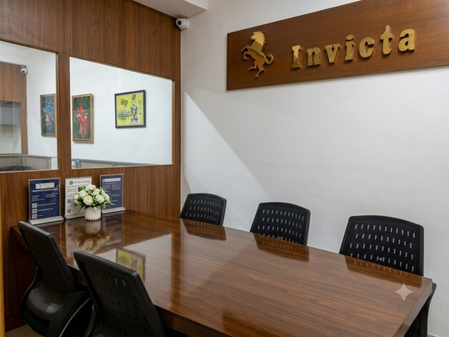
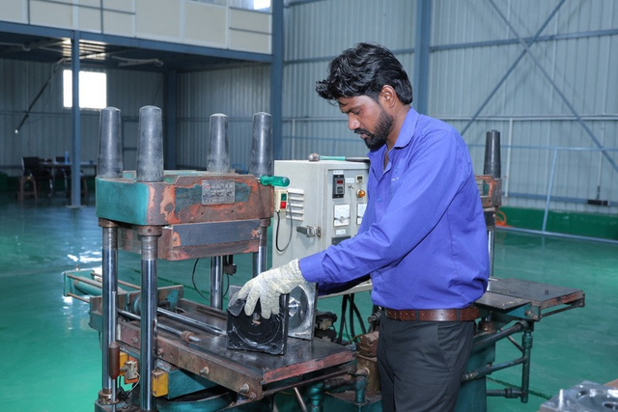
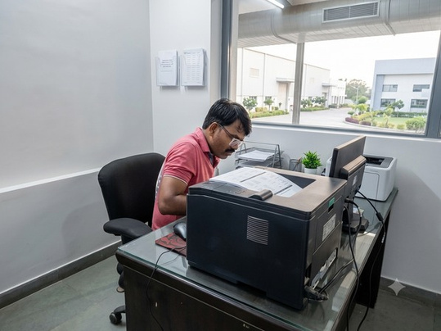
Company Overview
Storage
Pallet Area
Gasket area
Visitor Area
Molding section
Store office

Slide 12

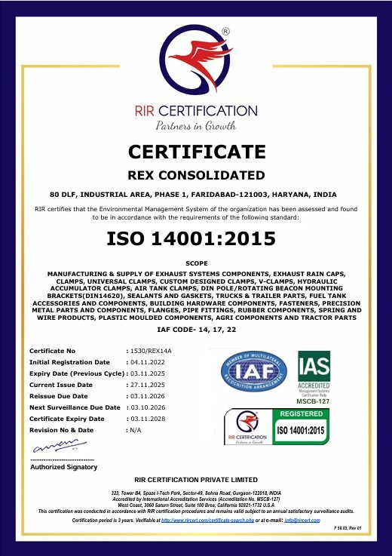
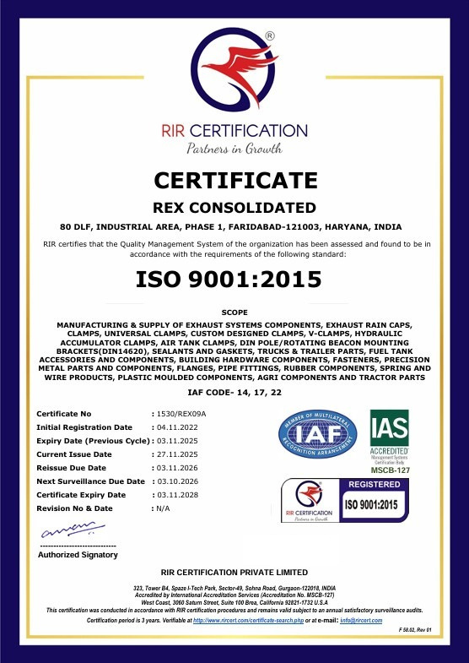
CERTIFICATIONS

Slide 13

Our Products

Slide 14
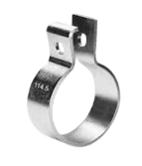
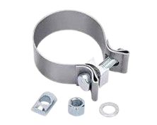
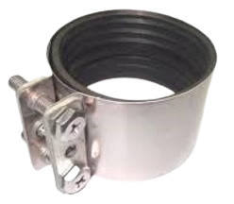
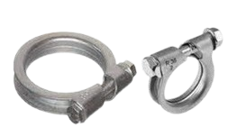
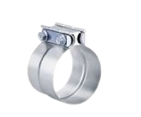
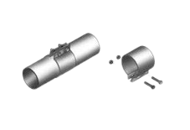
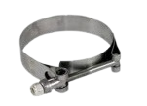
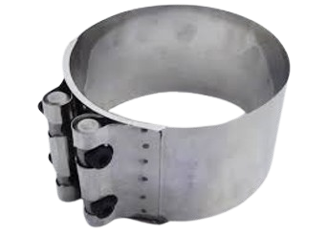
EXHAUST CLAMPS
ARS Pipe Clamp (Volvo Exhaust
DIN 71555 Clamp
Seal Clamp
RXD Drainage Clamp
Clamp)
Flat Clamp
Flexible Tight - Seal Clamp
Heat Shield Gaskets
Flexible Clamp Buttfit

Slide 15
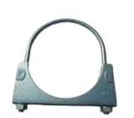
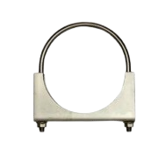
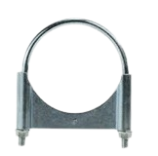
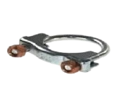
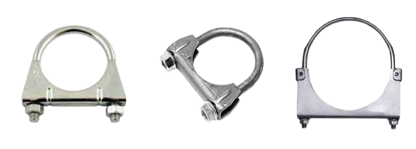
U-CLAMPS
Universal U BoltPipeClamps/UniversalExhaustClamps(M 8/ M10)

Slide 16
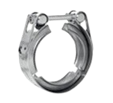
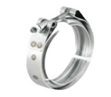

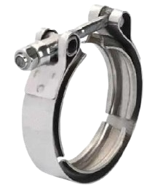


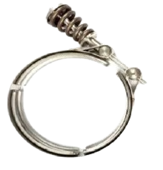
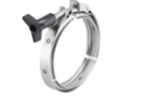
V-BAND CLAMPS
V-BAND CLAMP (EUROPEAN STYLE)
V-BAND CLAMP (T-BOLT)
DOUBLE HARDWARE T- BOLT V-BAND CLAMP
ROLL FORMED T-BOLT V-BAND CLAMP
WORM DRIVE V-BAND CLAMP
QUICK RELEASE V-BAND CLAMP
SPRING LOADED V BAND CLAMP
THUMB-TURN V-BAND CLAMP

Slide 17
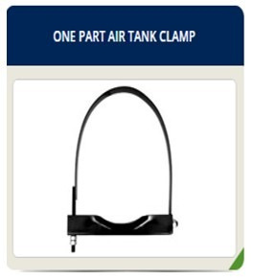
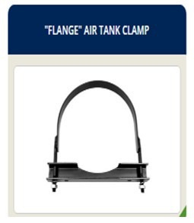
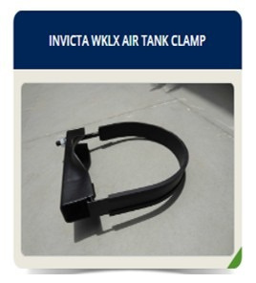
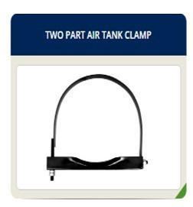
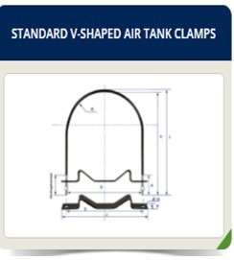

AIR TANK CLAMPS

Slide 18
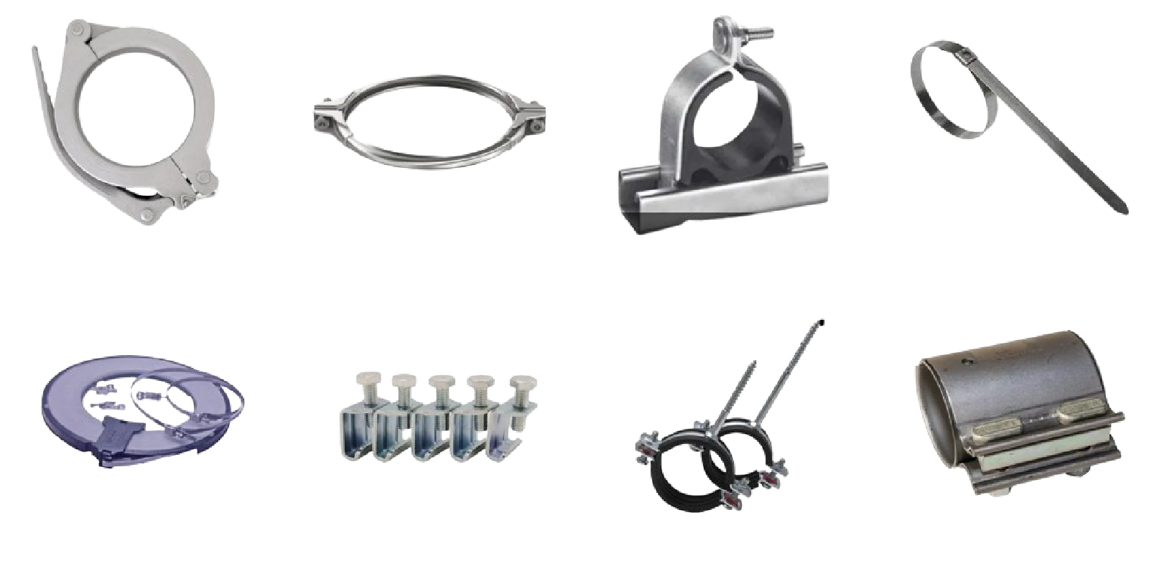
CLAMPS

Slide 19


CLAMPS

Slide 20








CLAMPS

Slide 21




INNOVATION
Laser welding
Leakage testing
Surface treatment
Tooling Making

Slide 22



FACILITIES
Plating
CNC Machining

Slide 23
OUR STRENGTHS
Why Global Customers Choose Invicta Clamps
🌍
Global Export Presence
🎯
Custom Engineering Solutions
⚙
Wide Product Portfolio
🚚
Reliable Global Supply Chain
🛡
Quality You Can Trust
🔩
Modern Manufacturing Facility
🤝
Customer-Focused Partnership
🏭
Established Manufacturing Excellence

Slide 24



Automated Machinery
Automated Clamp Manufacturing Machinery
Our advanced automated machinery ensures precise and efficient production of clamps with consistent quality and high productivity. Equipped with modern control systems, it minimizes manual intervention, reduces production time, and maintains tight dimensional accuracy. The automated process enables reliable performance, low defect rates, and cost-effective manufacturing for large-volume requirements.

Slide 25

Our Performance

Slide 26








Distribution & Global Reach Supply chain, logistics, and export markets.
Reliable Supply Chain & GlobalDelivery
Invicta Clamps serves customers across domestic and international markets through a robust supply chain and efficient logistics network. Our streamlined procurement, production, and distribution processes ensure timely deliveries while maintaining the highest standards of quality and reliability.
Key Highlights
Exporting to customers across Europe, North America, the Middle East, Asia, and other global markets
Strategic partnerships with freight forwarders and logistics providers
Flexible shipping options including EXW, FOB, CIF, and DDP terms
Efficient inventory management and production planning
Support for OEM, aftermarket, and industrial customers
Customized packaging solutions for domestic and export shipments
Reliable lead times and responsive customer support
25+ Countries Served*
500+ Customers Worldwide*
Sea, Air & Road Freight Solutions
Export-Focused Documentation & Compliance Support

Slide 27

OUR CUSTOMERS

Slide 28







LET'S CONNECT.
Invicta clamps
www.invictaclamps.com
+91-9810614124
rahul@invictaindia.com
invictaclamps
Invicta clamps
@invictaclamps

Slide 29
Q & A

