Slide 1

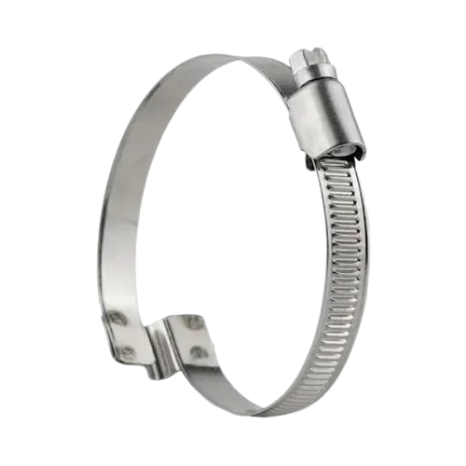
Welcome to Invicta Clamps
The Leading Clamping Solution

Slide 2
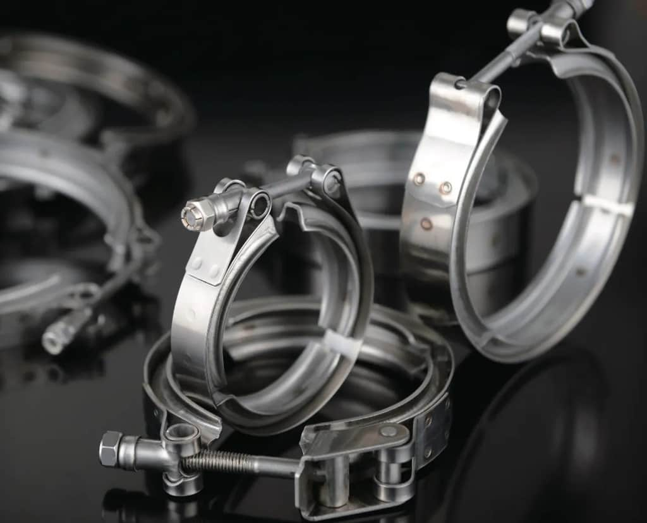
ABOUT US
Invicta Clamps is headquartered in Delhi, India and primarily operates in the lucrative niche category of clamping products. The company offers 20,000 products and solutions for a wide range of applications. Since 1980 Invicta has been at the fore front of clamp and connecting technology.With a comprehensive range and proven quality and reliability, Invicta clamps are second to none. All Invicta clamps are manufactured to stringent quality standards. We provide the most upto date range of clamping products for agricultural machinery, commercial vehicles, construction equipment, engines, aviation, infrastructure/construction/water management, passenger vehicles, railway, white goods, wholesalers, and technical distributors. Today Invicta Clamps are used by more than 1000 customers in 120 countries. With 7 production facilities and 10 warehouses, Invicta Clamps is continuing on its journey with consistent year-over-year growth in sales volume and R&D expenditure. With the support of our dedicated employees, we consistently products that exceed the expectations of our customers.

Slide 3

Company Hierarchy
MR.GOPAL CHOPRA
FOUNDER
MRS.KAVITA CHADHA
M.D
MR.RAHUL CHADHA
CEO
MR.PRAMOD KUMAR
PLANT HEAD
MR. INNOCENT THOMAS
PRODUCTION
MR.PHILIP
DESIGN & DEVELOPMENT
MR.NISHANT SHARMA
MARKETING
MR.TUSHAR
QUALITY

Slide 4




Testing and Quality Inspection
Unwavering Quality at Invicta Clamps
Precision Engineering
Our clamps are the result of meticulous and precise engineering. Every component, regardless of its size, undergoes stringent quality control to ensure a perfect fit and lasting performance, even in the most demanding applications.
At Invicta Clamps, we are dedicated to upholding the highest standards of quality in the manufacturing of our clamps. With a history of excellence spanning 45 years, our commitment to quality is the cornerstone of our legacy.
Durability and Reliability
Exceeding Expectations
Invicta Clamps are synonymous with durability and reliability. Designed to withstand the challenges of a wide range of industries, our clamps consistently deliver dependable performance.
Our promise is to exceed industry standards and customer expectations. We go the extra mile to ensure that our products are renowned for their quality and reliability. Invicta Clamps is your assurance of exceptional clamping solutions that you can rely on.

Slide 5


SOFTWARE CAPABILITIES
AutoCAD, VERACAD
SolidWorks, ProE, CATIA, NX, Creo
MATLAB, LaTEX, RC++, Python, JAVA
Forge 3D and Deform 3D : White Light Laser Scanning Machine, CMM
Instrumentation : LabVIEW
Finite Element Analysis : Ansys, Fluent
Analysis and Simulation: ANSYS, COMSOL, HyperMesh
SketchUp

Slide 6
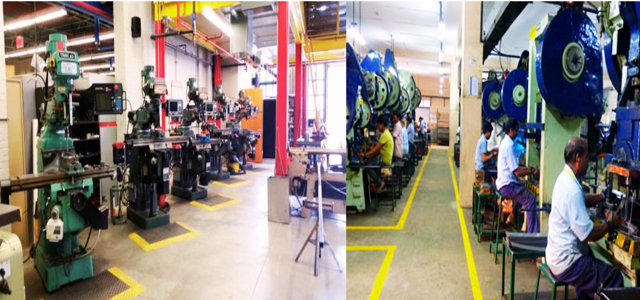
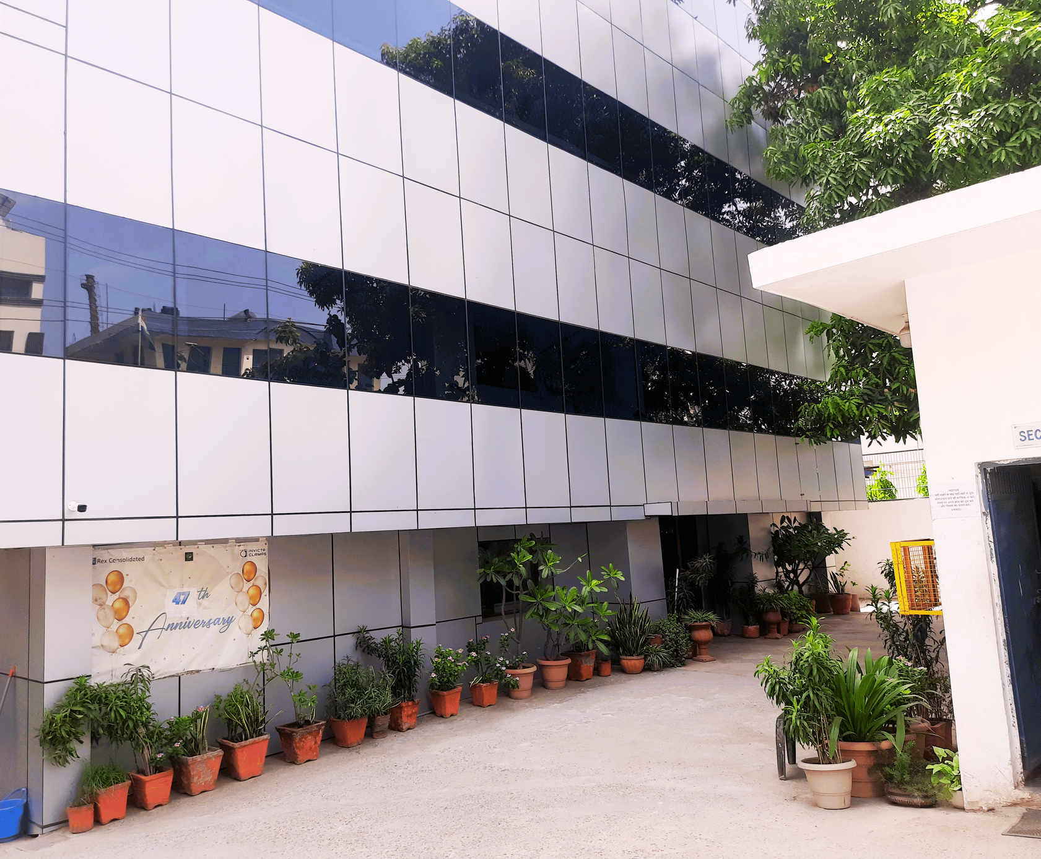

MANUFACTURING FACILITIES
& PLANT OVERVIEW

Slide 7

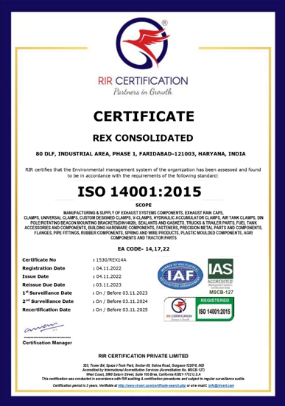
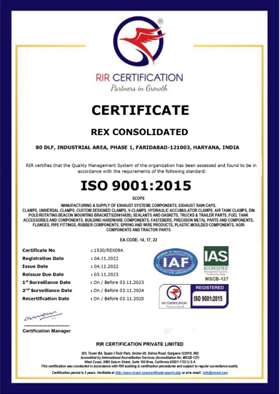
CERTIFICATIONS

Slide 8
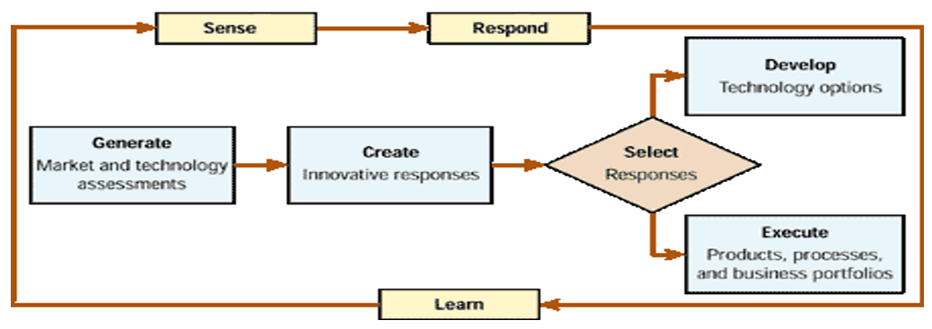
Research & Development
Invicta has a strong in-house R&D Team equipped with state of art design software andhardware.
Our R&D team regularly comes out new designs to meet challenging and time-bound requirements of ourcustomers

Slide 9

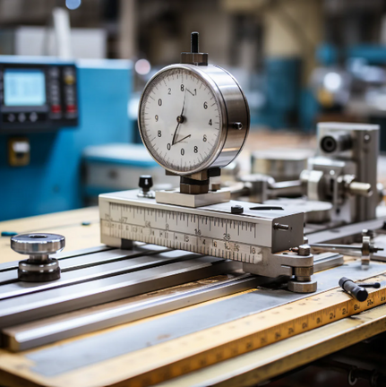


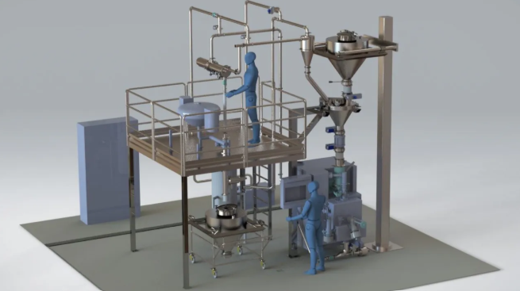
Our Manufacturing Process
The Proof is in
Our Performance
Precision Manufacturing
Excellence
Setting the Standard
for Quality
Your Assurance of Excellence
Pioneering the Future of Manufacturing

Slide 10

Our Products

Slide 11
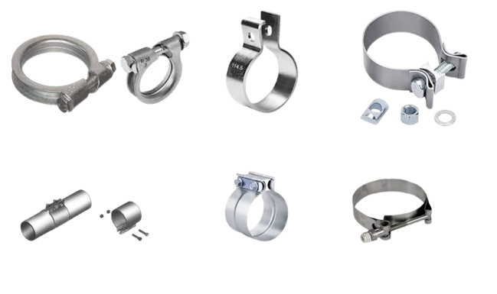
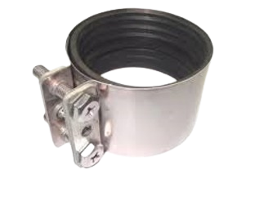
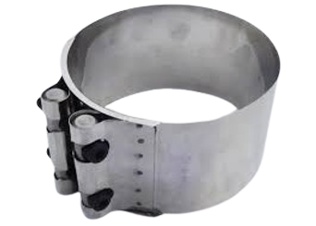
EXHAUST CLAMPS
ARS Pipe Clamp
(Volvo Exhaust Clamp)
DIN 71555 Clamp
Seal Clamp
RXD Drainage Clamp
Flat Clamp
Flexible Tight - Seal Clamp
Heat Shield Gaskets
Flexible Clamp Buttfit

Slide 12
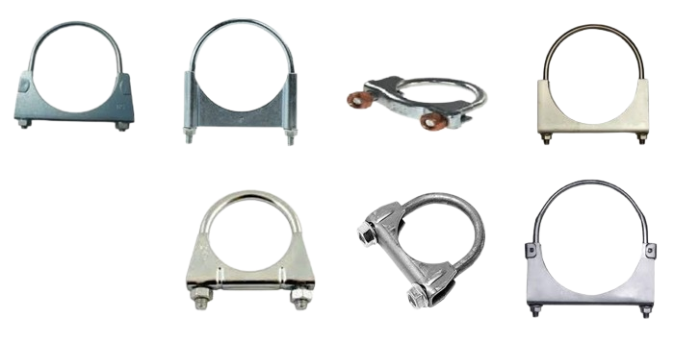
U-CLAMPS
Universal U Bolt Pipe Clamps / Universal Exhaust Clamps (M8 / M10)

Slide 13
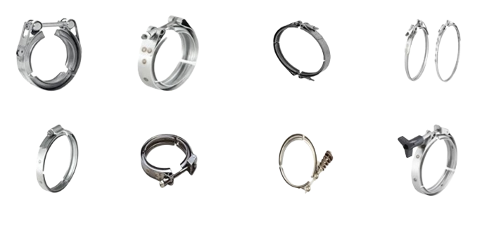
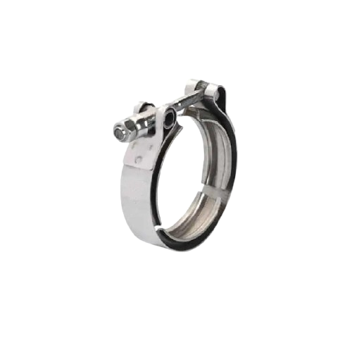
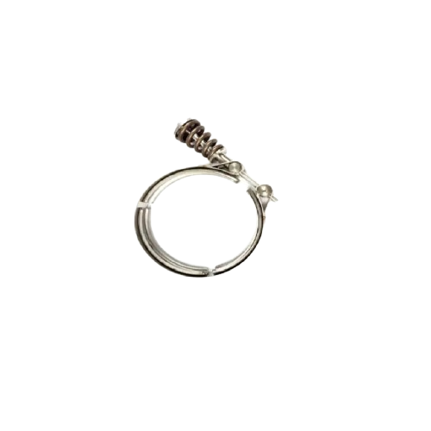
V-BAND CLAMPS
V-BAND CLAMP
(EUROPEAN STYLE)
V-BAND CLAMP
(T-BOLT)
DOUBLE HARDWARE
T-BOLT V-BAND CLAMP
ROLL FORMED T-BOLT
V-BAND CLAMP
WORM DRIVE
V-BAND CLAMP
QUICK RELEASE
V-BAND CLAMP
SPRING LOADED
V BAND CLAMP
THUMB-TURN
V-BAND CLAMP

Slide 14
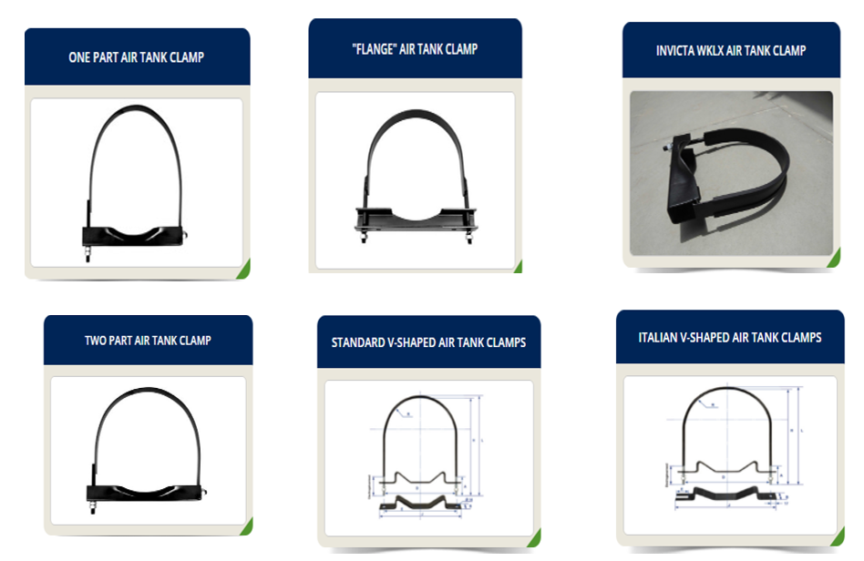
AIR TANK CLAMPS

Slide 15
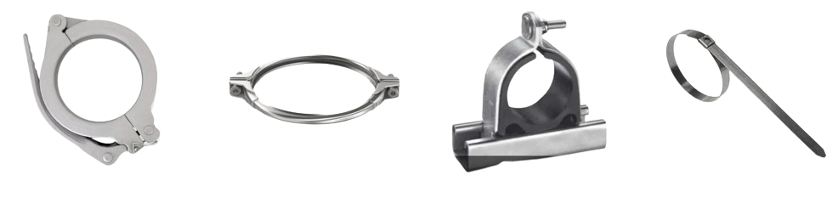
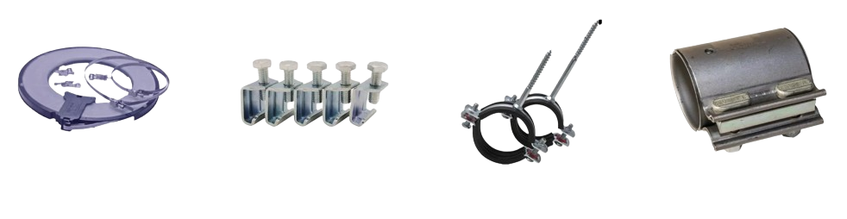
CLAMPS

Slide 16
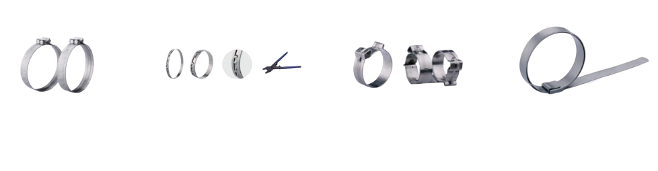
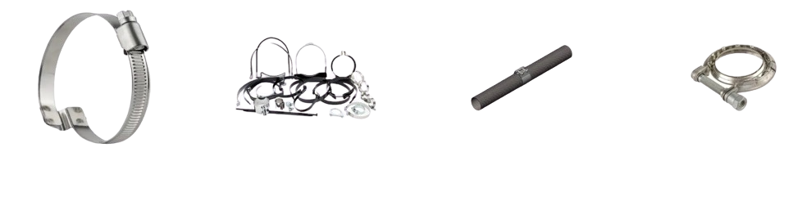
CLAMPS

Slide 17

VISION & GOALS
  At Invicta Clamps our vision is to be the leading provider of manufacturing solutions in the industry. We strive to achieve this by constantly pushing the boundaries of innovation, quality, and customer service
  Delivering high-quality engineered components across various industries.
  Investing in advanced technologies and equipment to enhance precision and efficiency.
  Maintaining rigorous quality control processes to ensure product reliability and safety.
  Fostering a team of skilled professionals dedicated to exceeding customer expectations.

Slide 18




INNOVATION
New Product Development
Revolutionary Manufacturing Methods
Providing Tailored Solutions
Sustainable Practices

Slide 19
OUR STRENGTHS
STAMPING
At Invicta Clamps, our vision is to be the leading provider of manufacturing solutions in the industry. We strive to achieve this by constantly pushing the boundaries of innovation, quality, and customer service.
MACHINING
At Invicta Clamps, we invest in the latest technology and equipment to provide our customers with the best possible products and services. We use advanced software and machinery to ensure precision and efficiency in all our processes.
SURFACE TREATMENT
At Invicta Clamps, we are proud to hold several industry certifications, including ISO 9001 and AS9100. These certifications demonstrate our commitment to quality, safety, and customer satisfaction.

Slide 20
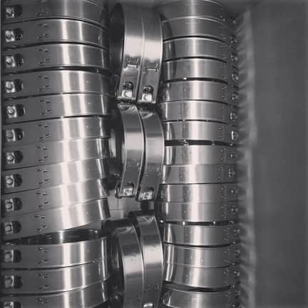
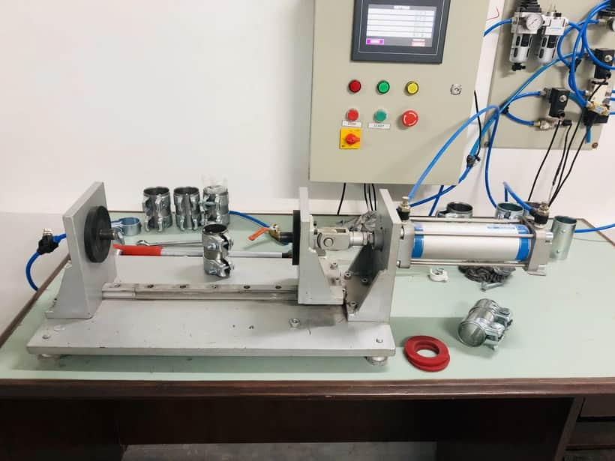
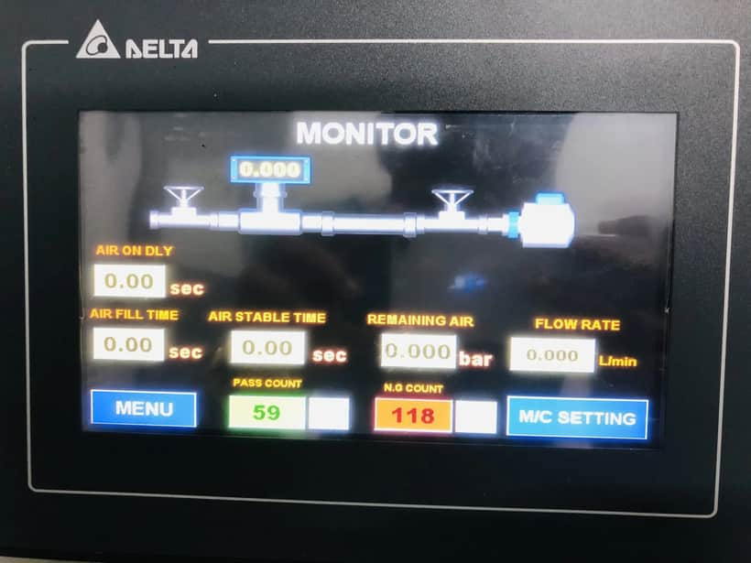
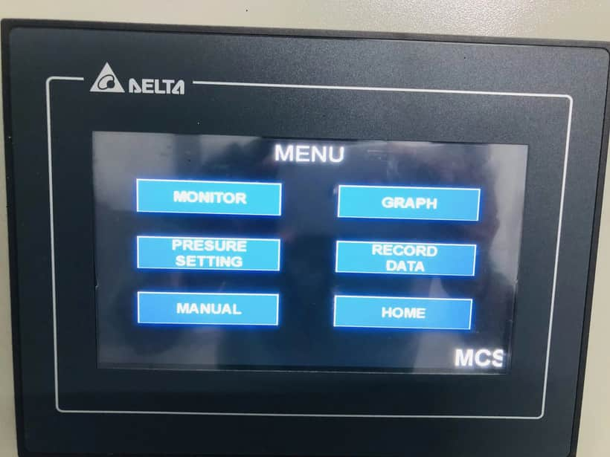
Technology
COMPUTER AIDED DESIGN AND PRODUCTION CONTROL
Our design team has over 40 years experience in design and manufacturing techniques. The latest 3D design software and database techniques are used to ensure the optimum effective and efficient designs are generated. Where required F.E.A. Techniques can be applied to optimise clamp design and prototypes can be fully tested at our laboratory. All design and manufacturing details are entered into our integrated business system and customer requirements are added to our bespoke MRP system which generates material and manufacturing demand.
Advanced Leakage Testing Technology
At Invicta Clamps, we are committed to delivering the highest quality products to our customers. To ensure that our clamps meet the stringent standards for performance and reliability, we are proud to introduce our latest innovation – an advanced Leakage Testing Machine. This custom-developed, cutting-edge technology allows us to meticulously measure the leakage from our clamps with unrivaled precision.

Slide 21
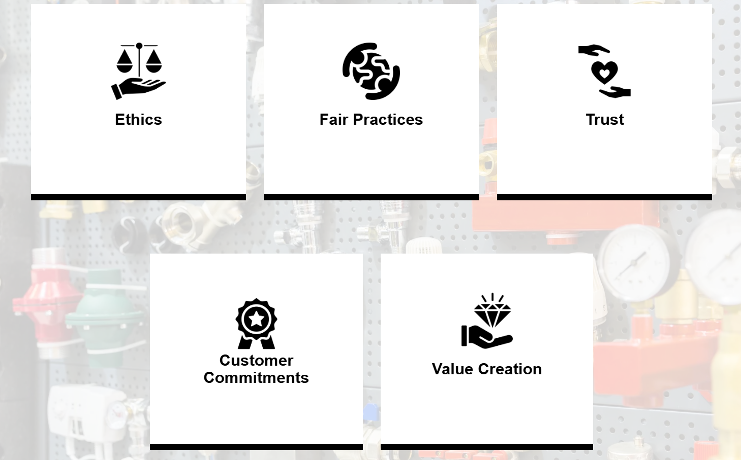
CORE VALUES

Slide 22





Distribution & Global Reach
Supply chain, logistics, and export markets.

Slide 23
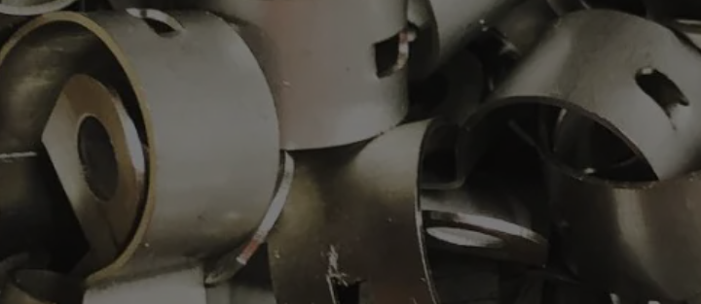
OUR MANFACTURING UNITS
FARIDABAD - 2 PLANTS
Delhi - 2 PLANTS

Slide 24

OUR CUSTOMERS

Slide 25







LET'S CONNECT.
Invicta clamps
www.invictaclamps.com
+91-9810614124
rahul@invictaindia.com
invictaclamps
Invicta clamps
@invictaclamps

Slide 26
THANK YOU

